Slide 1
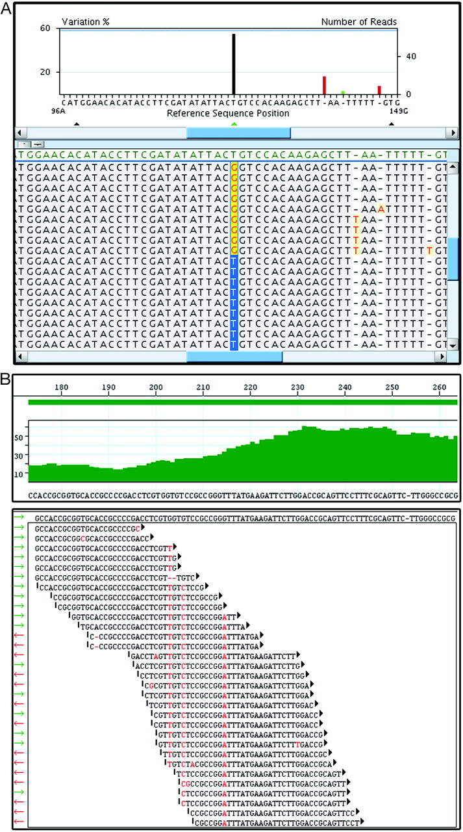

Examples of NGS data viewed in 2 different software systems
Voelkerding, K. V. et al. Clin Chem 2009;55:641-658
Copyright ©2009 American Association for Clinical Chemistry

